Slide 1


FULL STACK WEB DEVELOPMENT WITH JAVA
Lecture-5
(Advance jdbc-1)

Slide 2
TODAY’S AGENDA
Creating scrollable and updateable ResultSet .
ResultSet concurrency.
Insert update delete in Resultset

Slide 3
UPDATABLE AND SCROLLABLEE RESULTSET
By default the Resultset which we create in java are ResultSet’s which can only move in forward direction
And they also don’t allow any kind of changes made into them.
In order to change this behaviour we need to handle its TYPE (scrollability) & CONCURRENCY(updatability).

Slide 4
SETTING SCROLLABILITY AND CONCURRENCY
To set scrollability and updatability of the ResultSet we need to call the method createStatement( ) of the Connection object which has the following prototype:
public Statement createStatement(int scrollability,int
updatability) throws SQLException

Slide 5
RESULTSET SCROLLABILITY
ResultSet.TYPE_FORWARD_ONLY:
The cursor can only move forward in the result set.
i.e from before 1st row upto after the last row and it is also
the default type of ResultSet.
ResultSet.TYPE_SCROLL_INSENSITIVE:
The cursor can scroll forward and backward, and the ResultSet is not sensitive to the changes made by other users to the database after the result set was created. It can also move to an absolute position.

Slide 6
RESULTSET SCROLLABILITY
ResultSet.TYPE_SCROLL_SENSITIVE:
The cursor can scroll forward and backward, as well as to an absolute position and the result set is sensitive to changes made by other users after the result set was created.

Slide 7
RESULTSET CONCURRENCY
The possible ResultSet Concurrency are given below. If you do not specify any Concurrency type, you will automatically get one that is CONCUR_READ_ONLY.
ResultSet.CONCUR_READ_ONLY :
Creates a read-only result set. This is the default
ResultSet.CONCUR_UPDATABLE :
Creates an updateable result set.

Slide 8
RESULTSET CONCURRENCY
All our examples written so far can be written as
follows, which initializes a Statement object to create
a forward-only, read only ResultSet object
Statement stmt;
stmt=conn.createStatement(ResultSet.TYPE_FORWARD_ON
LY, ResultSet.CONCUR_READ_ONLY);

Slide 9
IMPORTANT RESULTSET METHODS
public void beforeFirst( ) throws SQLException Moves the cursor just before the first row.
public void afterLast() throws SQLException Moves the cursor just after the last row.
public boolean first() throws SQLException Moves the cursor to the first row.
public boolean last() throws SQLException Moves the cursor to the last row.

Slide 10
IMPORTANT RESULTSET METHODS
public boolean absolute(int row) throws SQLException Moves the cursor to the specified row.
public boolean relative(int row) throws SQLException Moves the cursor the given number of rows forward or backward, from where it is currently pointing.
public boolean previous() throws SQLExceptionMoves the cursor to the previous row.
public int getRow() throws SQLException Returns the row number that the cursor is pointing to.

Slide 11
UPDATING THE RESULTSET
It is a 3 step process
Place the record pointer at the desired location
We have to call the required updateXXX() method
- these methods are used for changing the values in
the column
prototype
public void updateXXX(int,XXX) throws
SQLException
int→ column position in ResultSet.
xxx→ new value we want to provide.

Slide 12
Conti.
For ex:
- the updateInt( ) method has:
public void updateInt(int,int)throws SQLException
- the updateString( ) method has:
public void updateString (int,string)throws
SQLException
These update method also have an overloaded version where 1st argument is string specifying column name-

Slide 13
Conti.
public void updateInt (String , int)
public void updateString (String , String)
After updation has been done we have to call the updateRow( ) method which finally transfers the changes to the database.

Slide 14
SAMPLE CODE
Statement st=conn.createStatement(ResultSet.TYPE_SCROLL_INSENSITIVE,ResultSet.CONCUR_UPDATABLE);
ResultSet rs=st.executeQuery("Select bookname,bookprice from allbooks ");
while(rs.next())
{
double amt=rs.getDouble(2);
rs.updateInt(2,amt+amt*.01);
rs.updateRow();
System.out.println(rs.getString(1)+”\t”+rs.getDouble(2));
}

Slide 15
EXERCISE
Imagine you have a table called “ALLBOOKS” , with 4 columns
as “bookid”,”bookname”,”subject” and “bookprice”. The
table has some records already present in it.
Write an application which updates the price of each JEE book
in the ALLBOOKS table by 10%.
At the end also display how many books were updated

Slide 16
EXERCISE
Modify the previous app so that at the end your code displays
the names of the books which were updated

Slide 17
EXERCISE
Again modify the previous app so that at the end your code
displays the complete details of the book (bookname,old price
and new price)which were updated

Slide 18
INSERTING RECORD IN THE RESULTSET
Insertion of a row require four steps:
We have to call a method called moveToInsertRow() of ResultSet , it moves the cursor to a special position called “insert row position”.
Add values to a specific column by calling updateXXX() method.
Call the method insertRow() of ResultSet ,so that the changes made are transferred to underlying database.
Call moveToCurrentRow() of ResultSet , so that the cursor moves back to the position where it was before calling moveToInsertRow().

Slide 19
EXERCISE
Write an application which accepts id,name,price and subject
from the user and inserts a new record in the table allbooks.

Slide 20
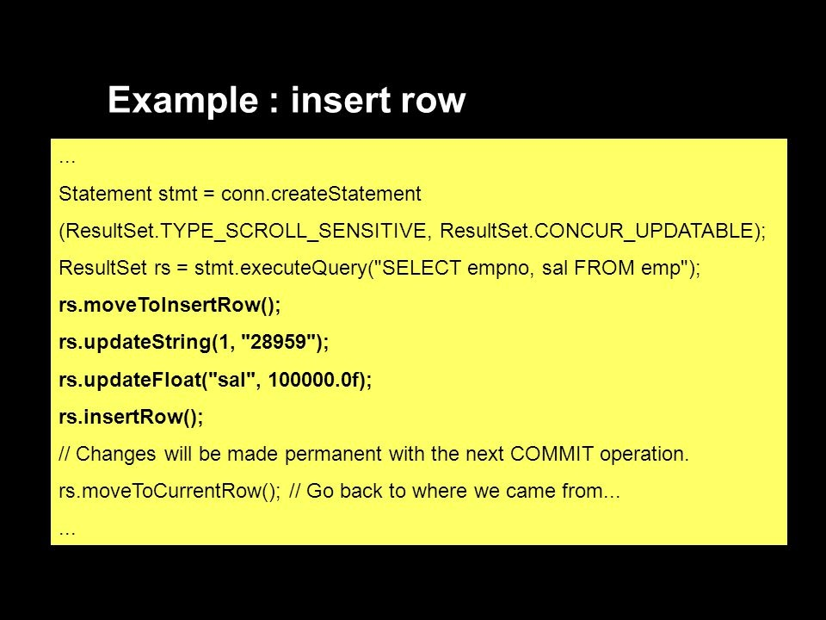
EXAMPLE

Slide 21
DELETE ROW
T0 delete any row from ‘resultset’ we just have to move the cursor to the desired position and then , we can call the method deleteRow() of resultSet.
Example :
rs.next(); /* Will move the record pointer to the next row */
rs.deleteRow();

Slide 22
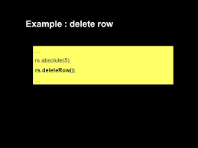
EXAMPLE

Slide 23
EXERCISE
Write an app that displays name of each book from the table
allbooks to the user and asks the user whether he wants to
delete it or not.
If the user says “yes” then the book should be removed.
At the end display the total books deleted as well as their names.

